Slide 1


Floquet Geometric Squeezing in Fast-Rotating Condensates
Han Pu
Rice University
15th AIMS conference: Adv. in mathematical modeling and numerical simulation of superfluids, Athens, Greece, July 2026

Slide 2
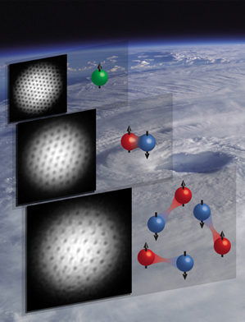
Outline
Introduction: fast-rotating BEC
Experiment: geometric squeezing of a fast-rotating BEC
Theoretical proposal: two-mode squeezing in a fast-rotating BEC

Slide 3
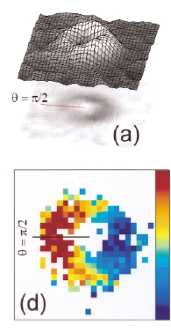
Fast-rotating BEC: quantized vortices
Flow without dissipation, irrotational
Rotation can penetrate into superfluid only as vortices
Quantized vortices: hallmark of superfluidity
Vortex lattice
Rotating freq. cannot exceed harmonic trapping freq.
Rotation → synthetic magnetic field
First demonstration of vortex in BEC
Wieman, Cornell, PRL 83, 2498 (1999).

Slide 4
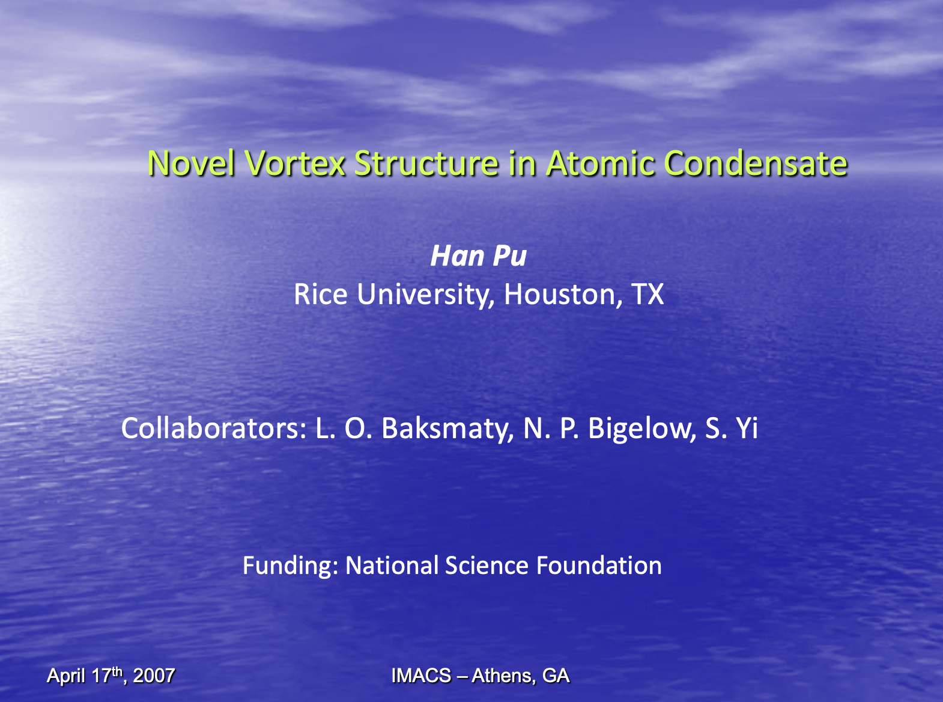
Fast-rotating BEC: quantized vortices

Slide 5
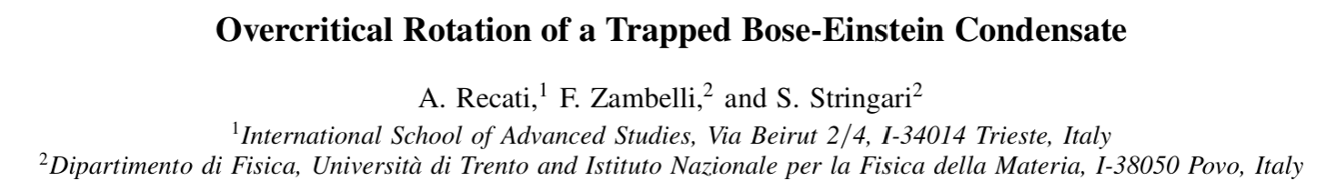

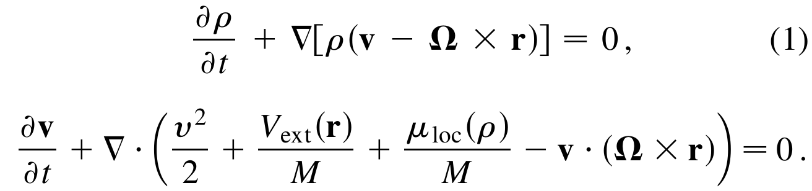
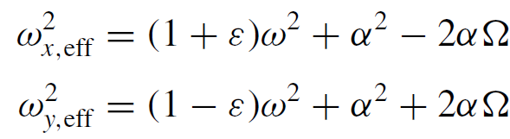
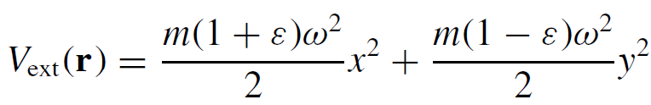
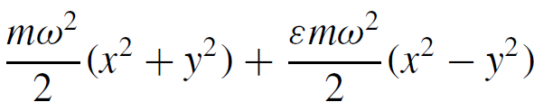

Fast-rotating BEC: quantized vortices
PRL 86 377 （2001）
A (metastable) non-vortical steady-state solution is found for a fast-rotating BEC.
$$ψ=\sqrt{ρ}e^{iS}, v=\frac{ℏ}{M}∇S$$

Slide 6
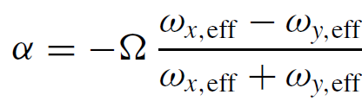
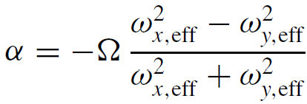
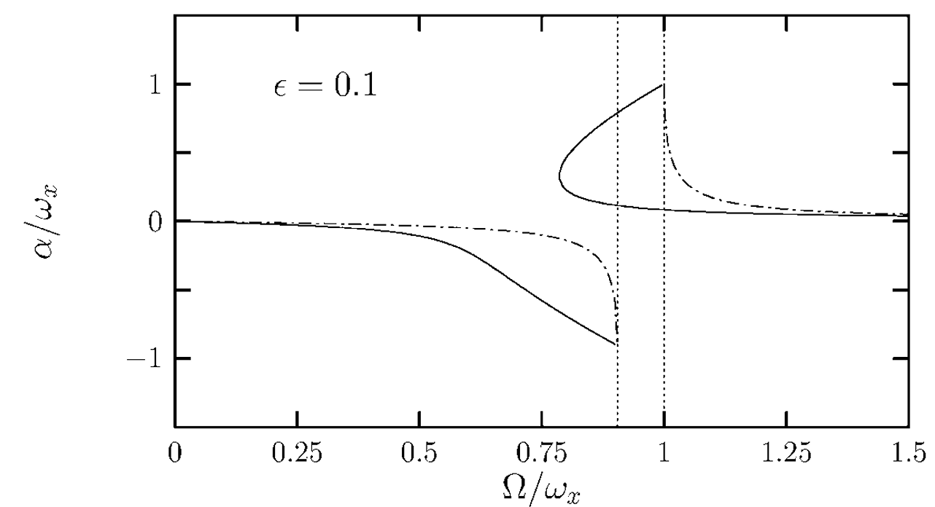
Fast-rotating BEC: quantized vortices
Non-interacting BEC: $ρ\left(x,y\right) \sim e^{−m\left(ω_{x,eff}x^{2}+ω_{y,eff}y^{2}\right)}$
Strongly-interacting BEC: $ρ\left(x,y\right) \sim μ−m\left(ω_{x,eff}^{2}x^{2}+ω_{y,eff}^{2}y^{2}\right)$/2
non-interacting
interacting
Such a solution exists even when the rotating freq. exceeds the trapping freq.

Slide 7
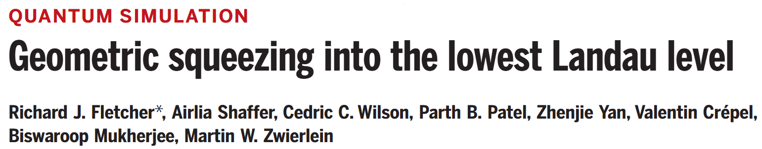
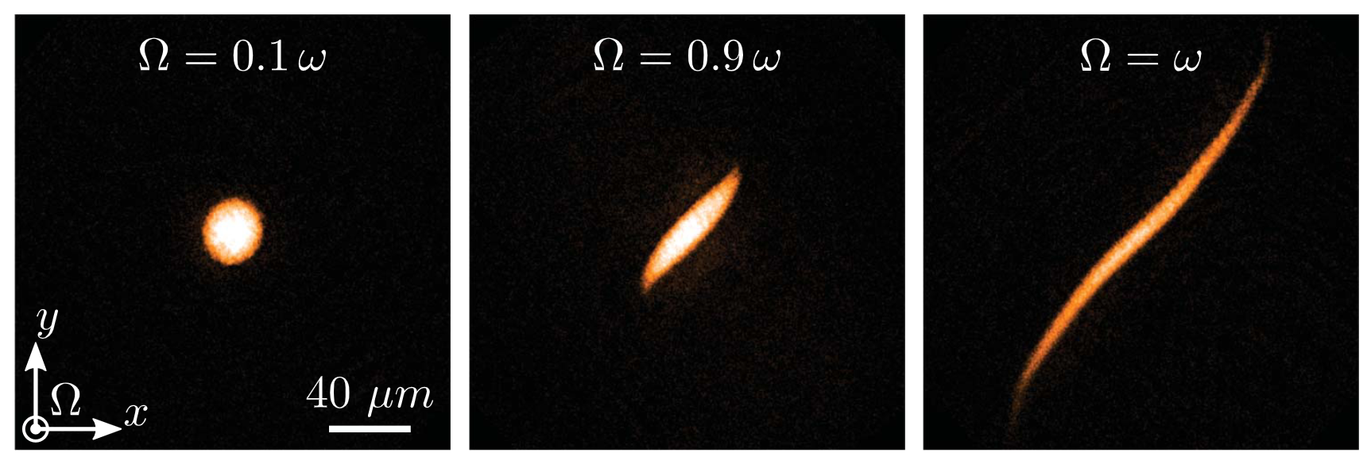
Experiment
Science 372, 1318 (2021)

Slide 8
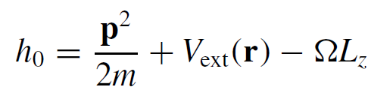




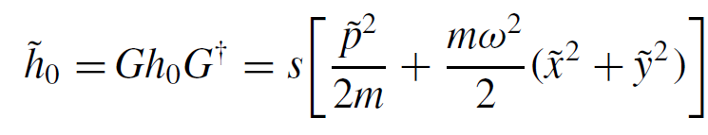

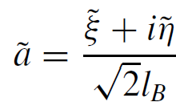
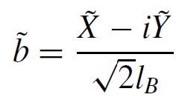
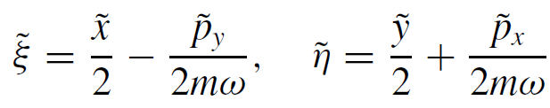
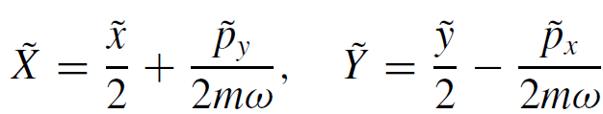





Theory: guiding-center mode squeezing
Unitary transformation under
cyclotron mode
guiding-center mode
Two pairs of new conjugate variables:

Slide 9
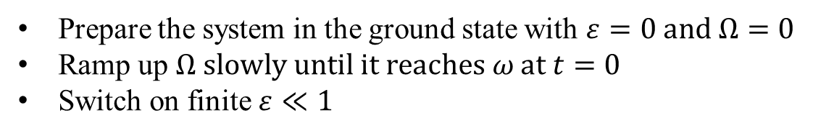
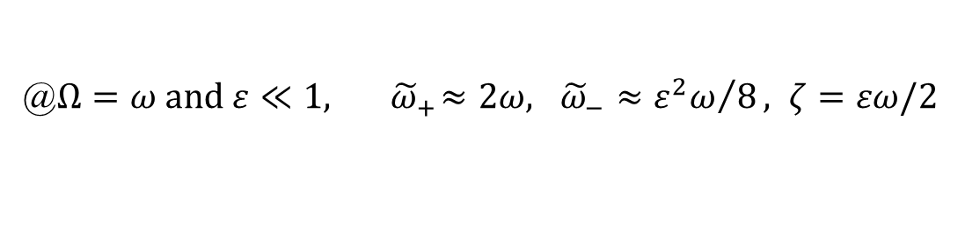
Theory: guiding-center mode squeezing
@$Ω=ω and ε≪1, { \tilde{ω}}_{+}≈2ω, {\tilde{ω}}_{−}≈{ε^{2}ω}/8, ζ=εω/2$
Quenching protocol:
Prepare the system in the ground state with $ε=0 and Ω=0$
Ramp up $Ω slowly until it reaches ω at t=0$
Switch on finite $ε≪1$
Mode a evolves under $h_{a}={\tilde{ω}}_{+}{\tilde{a}}^{†}\tilde{a}−\frac{ζ}{2}\left({\tilde{a}}^{2}+h.c.\right)≈2ω{\tilde{a}}^{†}\tilde{a}$
Mode b evolves under $h_{b}={\tilde{ω}}_{−}{\tilde{b}}^{†}\tilde{b}+\frac{ζ}{2}\left({\tilde{b}}^{2}+h.c.\right)≈\frac{ζ}{2}\left({\tilde{b}}^{2}+h.c.\right)$
Mode a stays in the ground state, Mode b becomes squeezed

Slide 10
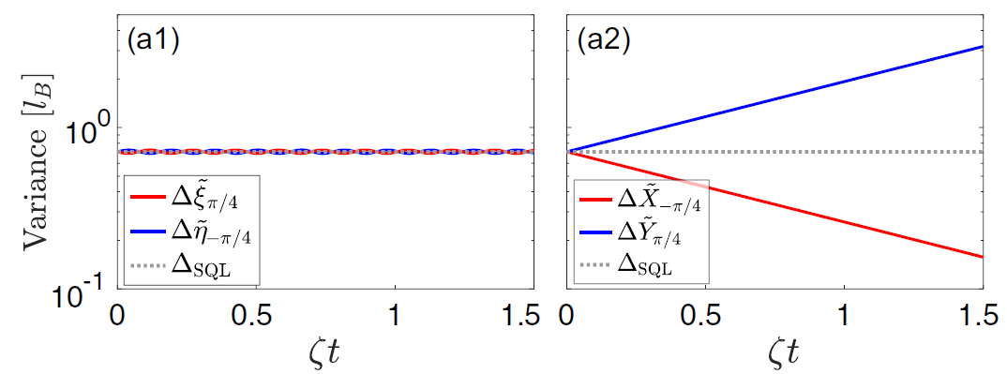

Theory: guiding-center mode squeezing
Mode a evolves under $h_{a}={\tilde{ω}}_{+}{\tilde{a}}^{†}\tilde{a}−\frac{ζ}{2}\left({\tilde{a}}^{2}+h.c.\right)≈2ω{\tilde{a}}^{†}\tilde{a}$
Mode b evolves under $h_{b}={\tilde{ω}}_{−}{\tilde{b}}^{†}\tilde{b}+\frac{ζ}{2}\left({\tilde{b}}^{2}+h.c.\right)≈\frac{ζ}{2}\left({\tilde{b}}^{2}+h.c.\right)$
$Δ{\tilde{X}}_{min}$=$Δ_{SQL}e^{−ζt}$
Numerical results from original Hamiltonian:

Slide 11
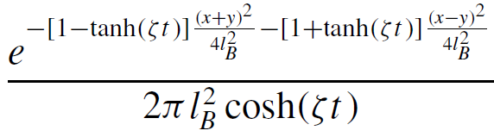

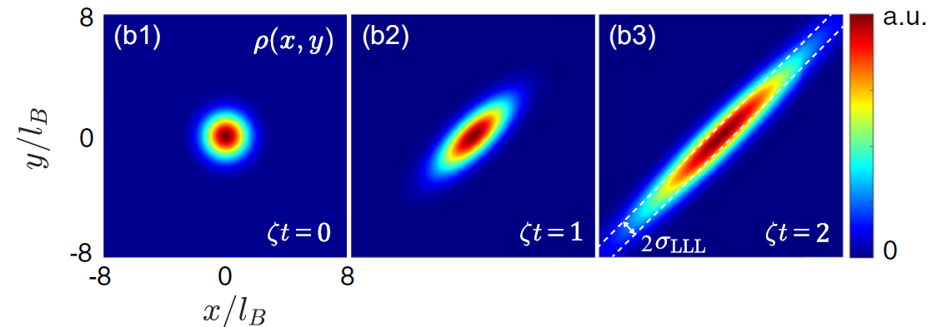
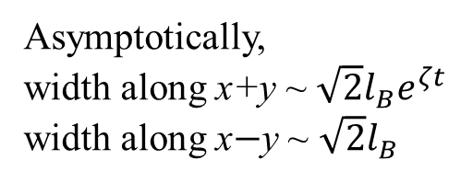
Theory: guiding-center mode squeezing
Mode a evolves under $h_{a}={\tilde{ω}}_{+}{\tilde{a}}^{†}\tilde{a}−\frac{ζ}{2}\left({\tilde{a}}^{2}+h.c.\right)≈2ω{\tilde{a}}^{†}\tilde{a}$
Mode b evolves under $h_{b}={\tilde{ω}}_{−}{\tilde{b}}^{†}\tilde{b}+\frac{ζ}{2}\left({\tilde{b}}^{2}+h.c.\right)≈\frac{ζ}{2}\left({\tilde{b}}^{2}+h.c.\right)$
Density distribution in x-y plane:
Asymptotically,
width along x+y ~ $\sqrt{2}l_{B}e^{ζt}$
width along x$−$y ~ $\sqrt{2}l_{B}$

Slide 12


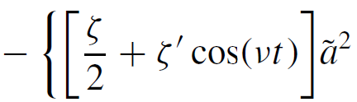
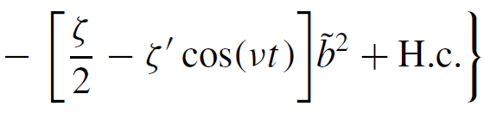

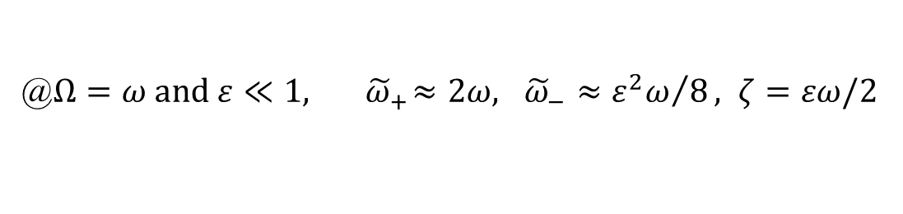
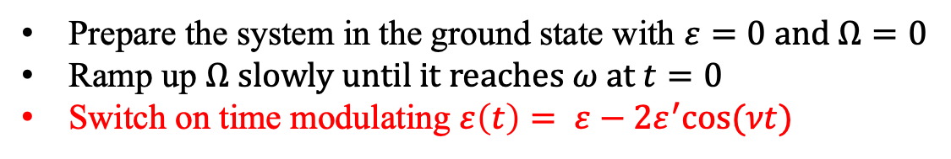
Theory: Floquet engineering
@$Ω=ω and ε≪1, { \tilde{ω}}_{+}≈2ω, {\tilde{ω}}_{−}≈{ε^{2}ω}/8, ζ=εω/2$
The large energy gap ${\tilde{ω}}_{+} prevents Mode a gets squeezed.$
To overcome this, consider a Floquet scheme.
Prepare the system in the ground state with $ε=0 and Ω=0$
Ramp up $Ω slowly until it reaches ω at t=0$
Switch on time modulating $ε\left(t\right)= ε−2ε^{′}cos⁡(νt)$
Unitary transformation under

Slide 13

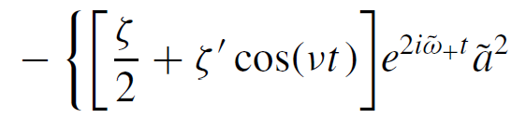
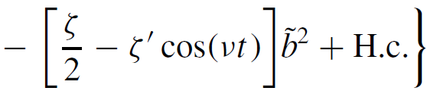

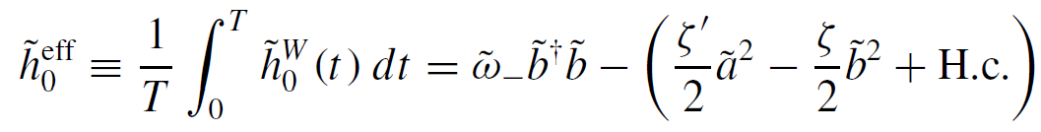

Theory: Floquet engineering
Unitary transformation under
Stroboscopic effective Hamiltonian @

Slide 14
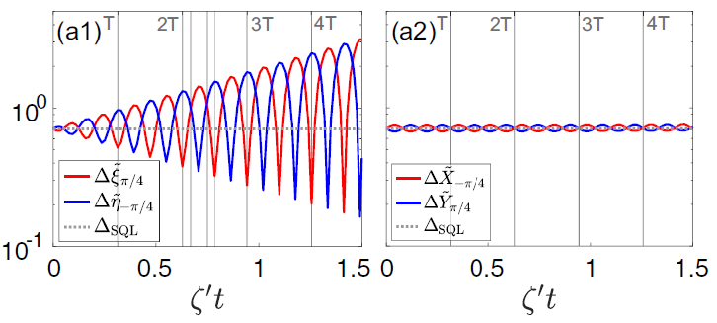




Theory: cyclotron mode squeezing
Stroboscopic effective Hamiltonian @
$$ε\left(t\right)= ε−2ε^{′}cos⁡(νt)$$
Compare:
To squeeze Mode a only: $ε=0$
Quadrature fluctuation @$t=nT$:
$Δ{\tilde{ξ}}_{min}$=$Δ_{SQL}e^{−ζ^{′}t}$

Slide 15
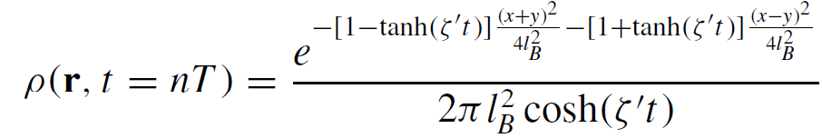
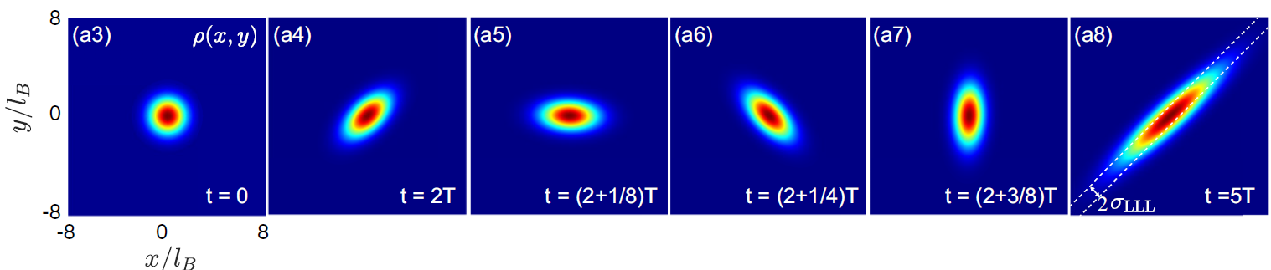

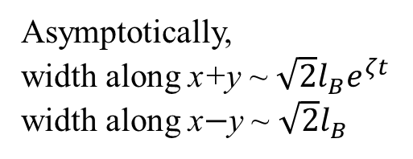

Theory: cyclotron mode squeezing
Stroboscopic effective Hamiltonian @
$$ε\left(t\right)= ε−2ε^{′}cos⁡(νt)$$
To squeeze Mode a only: $ε=0$
Density distribution in x-y plane @$t=nT$:
Asymptotically,
width along x+y ~ $\sqrt{2}l_{B}e^{ζt}$
width along x$−$y ~ $\sqrt{2}l_{B}$

Slide 16
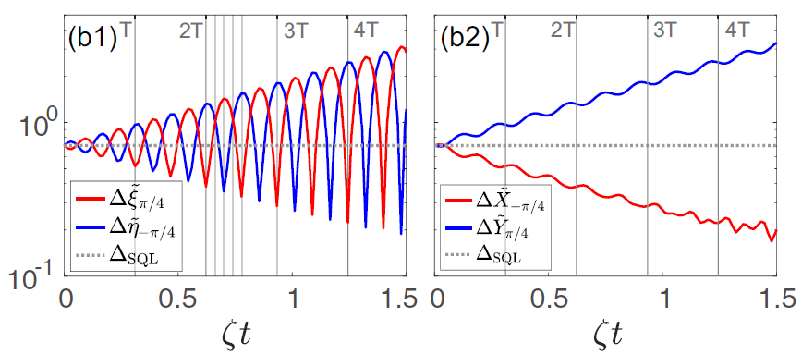

Theory: two mode squeezing
Stroboscopic effective Hamiltonian @
$$ε\left(t\right)= ε−2ε^{′}cos⁡(νt)$$
To squeeze both Mode a and b: $ε=ε^{′}$

Slide 17
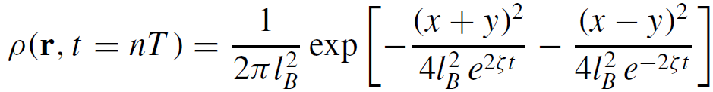
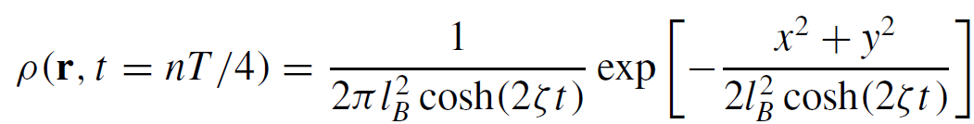

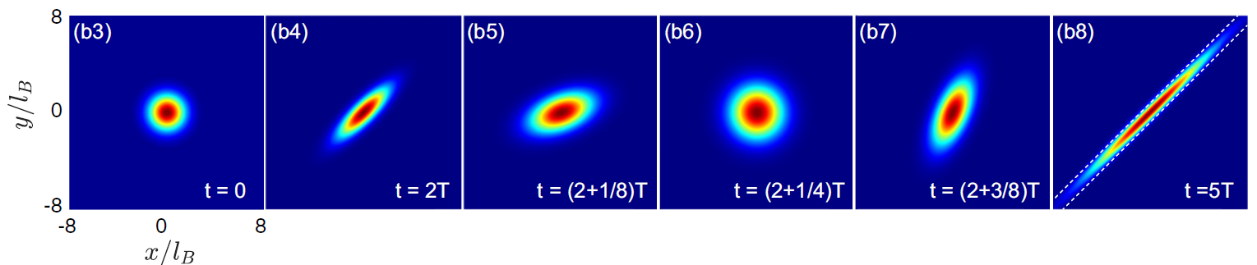

Theory: two mode squeezing
Stroboscopic effective Hamiltonian @
$$ε\left(t\right)= ε−2ε^{′}cos⁡(νt)$$
To squeeze both Mode a and b: $ε=ε^{′}$
Density distribution in x-y plane :

Slide 18
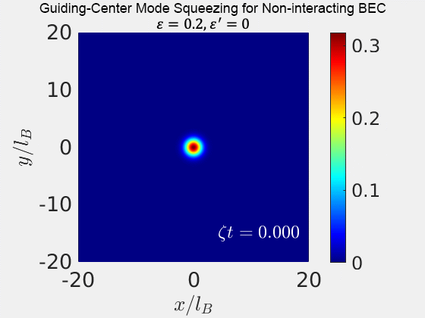
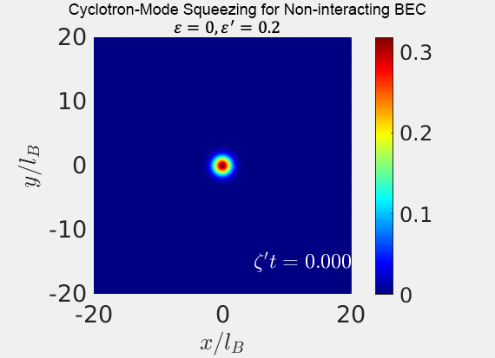

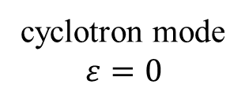
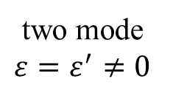

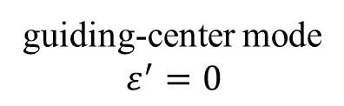
Theory: geometric squeezing (non-interacting) BEC
$$ε\left(t\right)= ε−2ε^{′}cos⁡(νt)$$
guiding-center mode
$$ε^{′}=0$$
cyclotron mode
$$ε=0$$
two mode
$$ε=ε^{′}≠0$$
Phys. Rev. A 111， L011303 （2025）

Slide 19
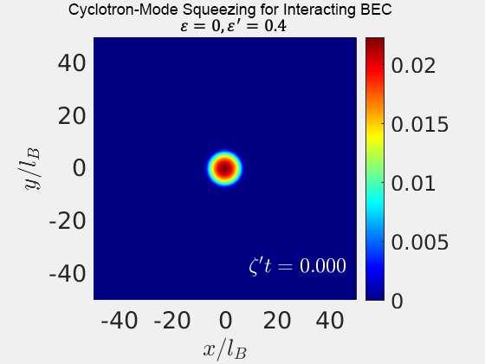
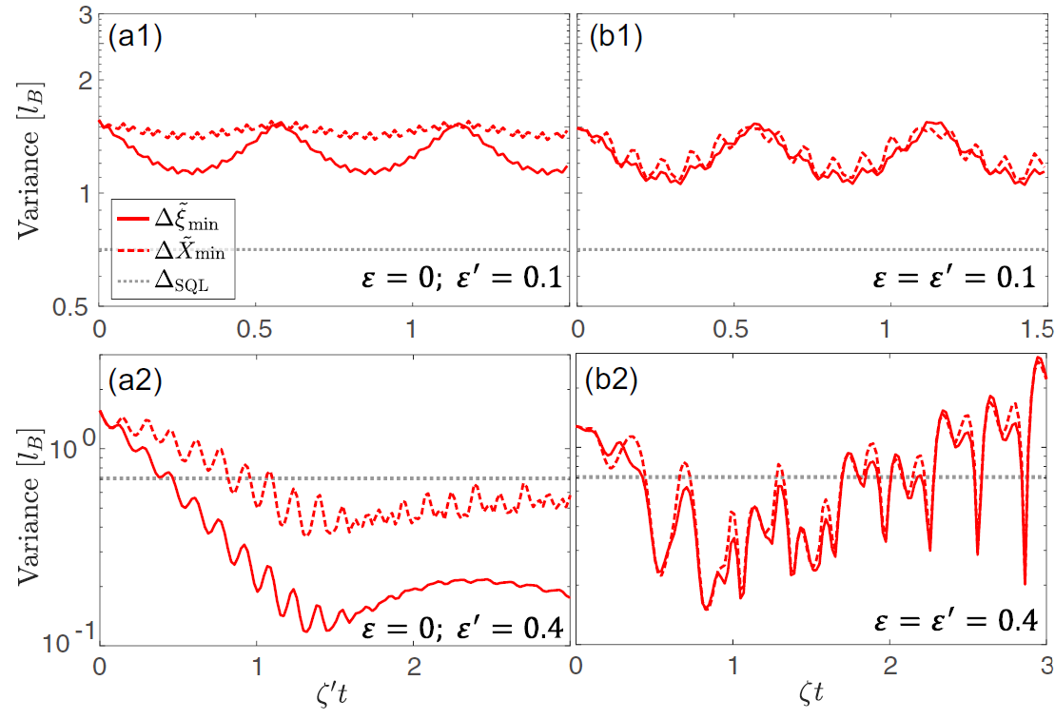
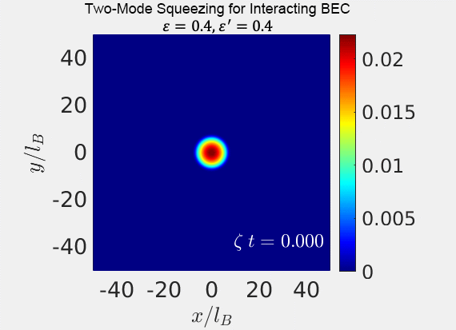

Theory: geometric squeezing for interacting BEC
$$ε\left(t\right)= ε−2ε^{′}cos⁡(νt)$$
Efficient squeezing for interacting BEC requires larger trap anisotropy.
Phys. Rev. A 112， 043319 （2025）

Slide 20

Conclusion and Acknowledgment
Rotating BEC can simulate squeezing
Role of interaction?
Role of quantum statistics (fermions)?
Phys. Rev. A 111， L011303 （2025）
Phys. Rev. A 112， 043319 （2025）
Li Chen (Shanxi Univ.)

